Slide 1
Distributed testing by funkload
Team 26
Project 6

Slide 2
Funkload
Funkload is a functional and stress test tool that can be used on your web applications.
Stress tests are implemented as PyUnit tests, so they can also be used as functional tests
Funkload provides nice reporting features out of the box: you can do trends and diff reports - You can monitor the server being tested
Performance testing: by loading the web application and monitoring your servers it helps you to pinpoint bottlenecks, giving a detailed report of performance measurement.

Slide 3
A simple test-case model in funkload
import unittest
from random import random
from funkload.FunkLoadTestCase import FunkLoadTestCase
class Simple(FunkLoadTestCase):
def setUp(self):
self.server_url = self.conf_get('main', 'url')
def test_simple(self):
server_url = self.server_url res = self.get(server_url, description='Get url')
self.assertEqual(res.code, 200)
self.assertEqual(res.body, "Hello World")
if __name__ in ('main', '__main__'):
unittest.main()

Slide 4
Bench configuration.
The testing can be performed for various bench configurations.
The following tests are performed for these configurations.
Cycles of concurrent users: [1, 10, 20]
Cycle duration: 10s
Sleep time between requests: from 0.0s to 0.5s
Sleep time between test cases: 0.01s
Startup delay between threads: 0.01s

Slide 5
Distributed Testing
Funkload has a built-in support to distribute the charge amongst several nodes.
Funkload achieves this distributed testing by driving the nodes via SSH using Paramiko.
Distributed bench testing:
fl-run-bench --distribute --distribute-workers=node1,node2 test_case.py
Building Reports:
fl-build-report --html -o html distributed-simple-test.log/node1-simple-bench.xml
Funkload with let you monitor:
fl-monitor-ctl monitor.conf start

Slide 6
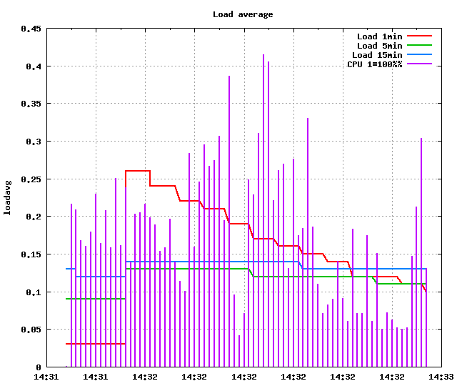
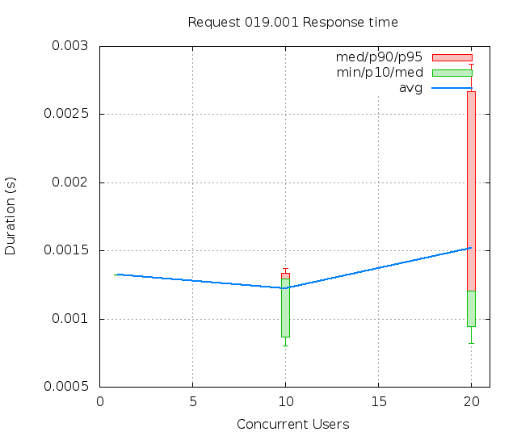
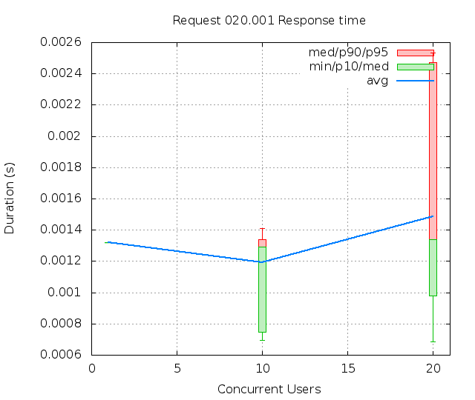
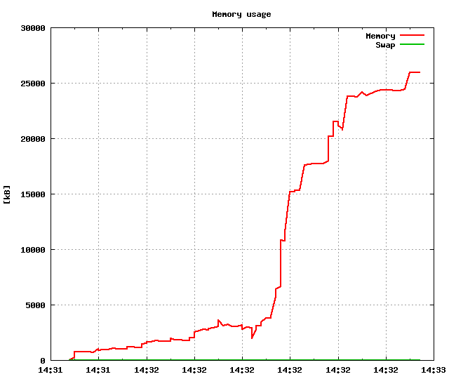
Apache server Testing results

Slide 7
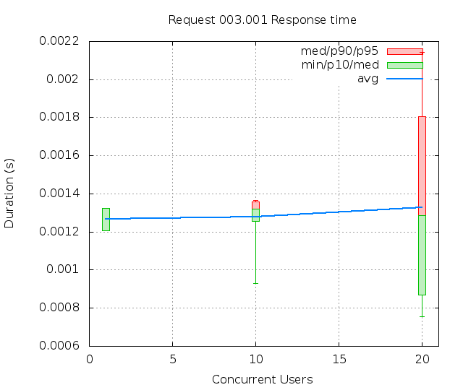
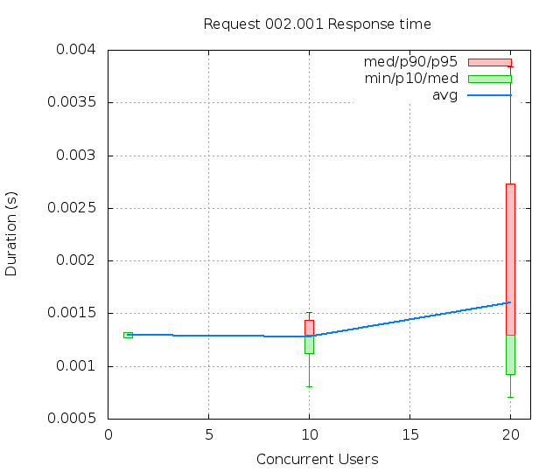
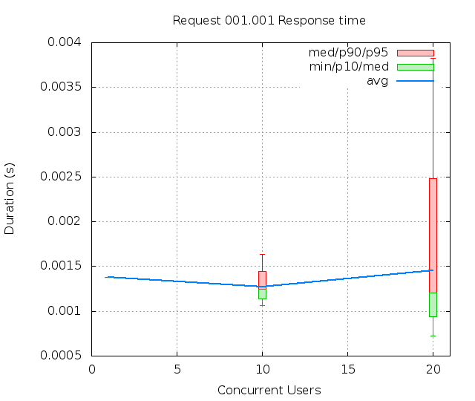
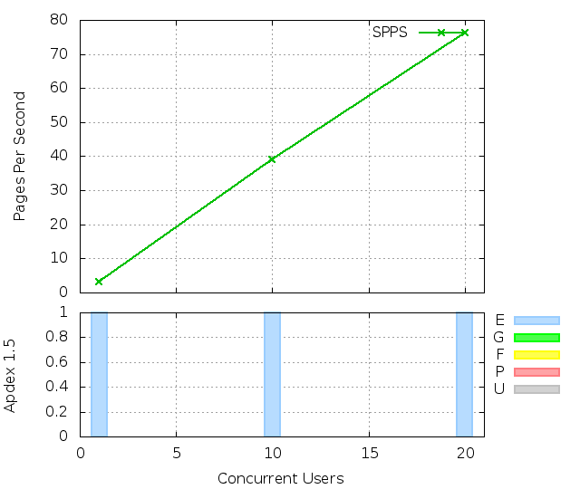
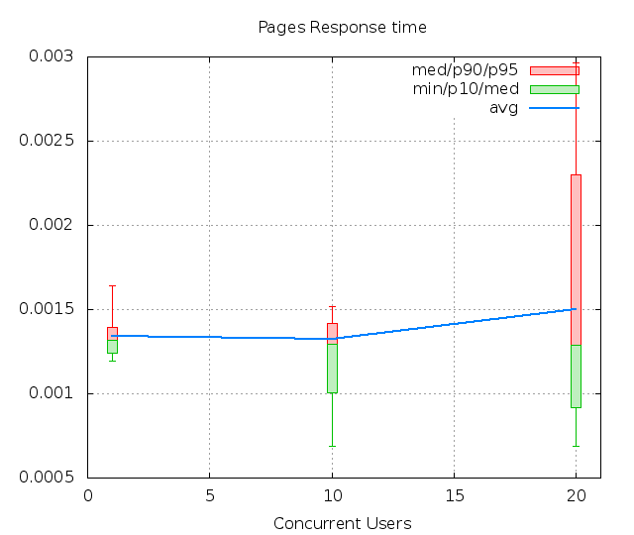
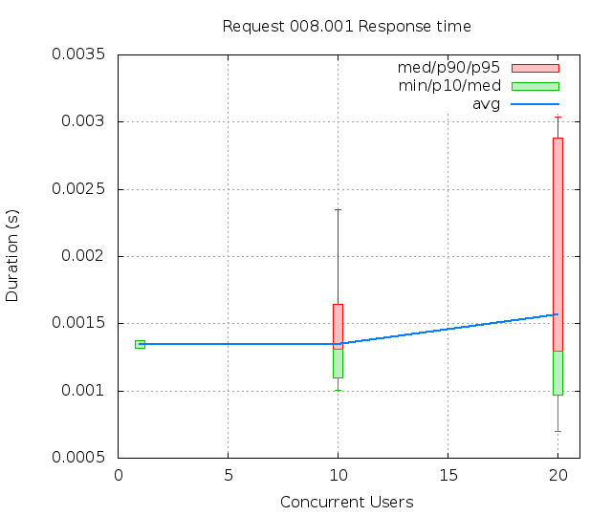
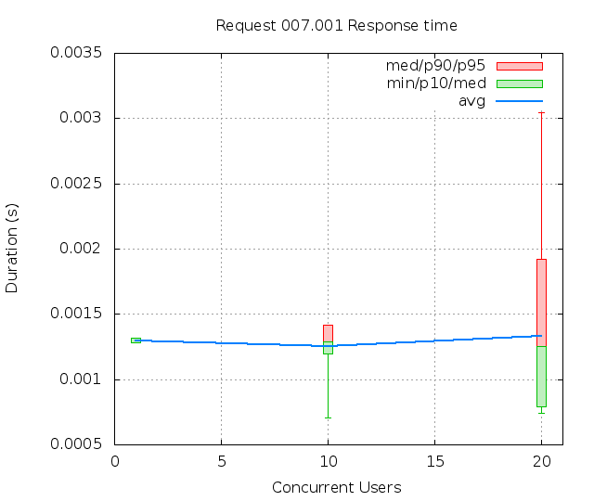
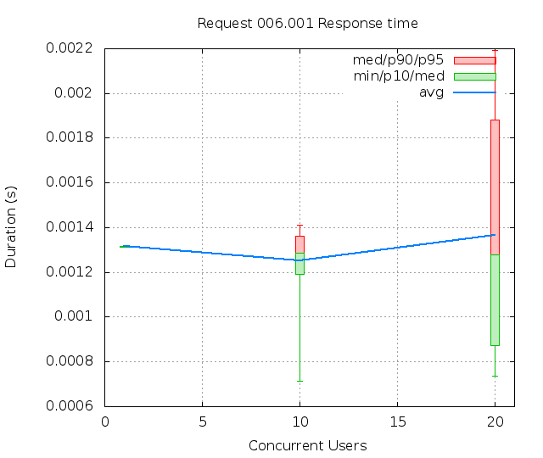

Slide 8
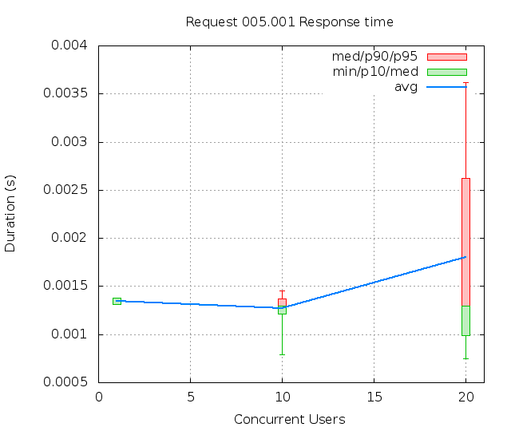
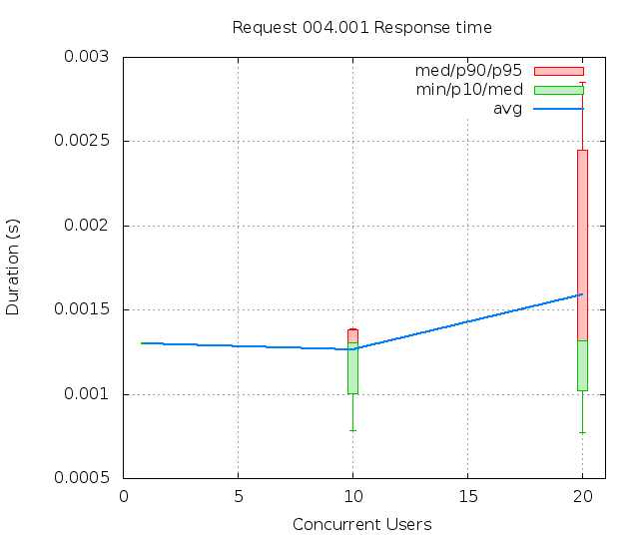
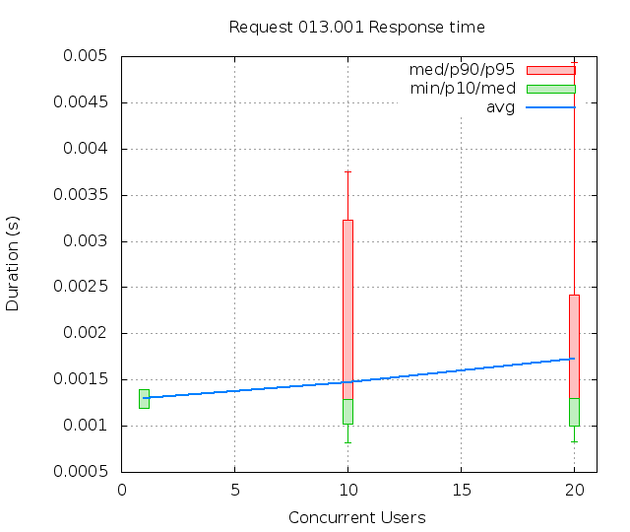
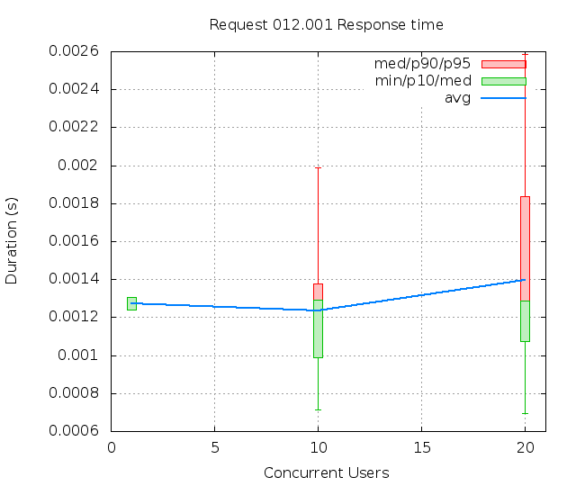
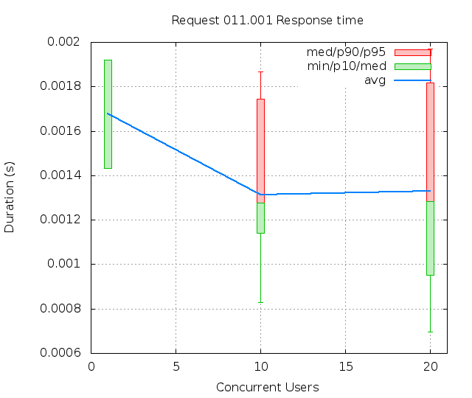
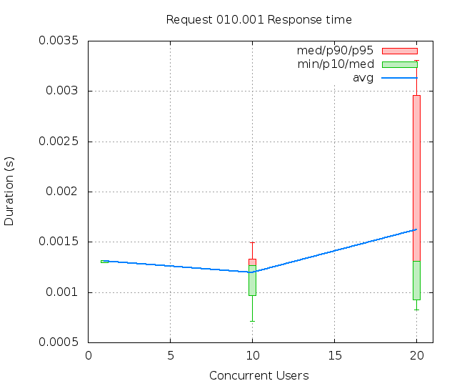
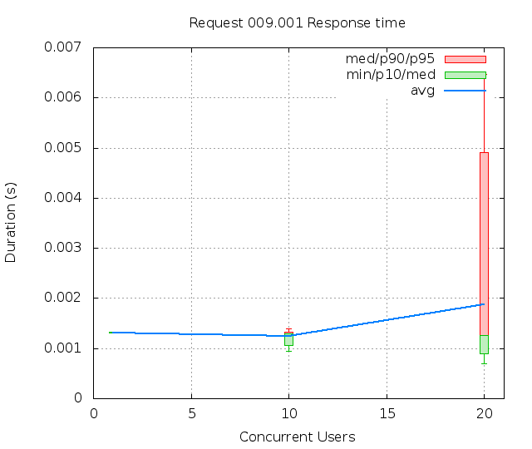
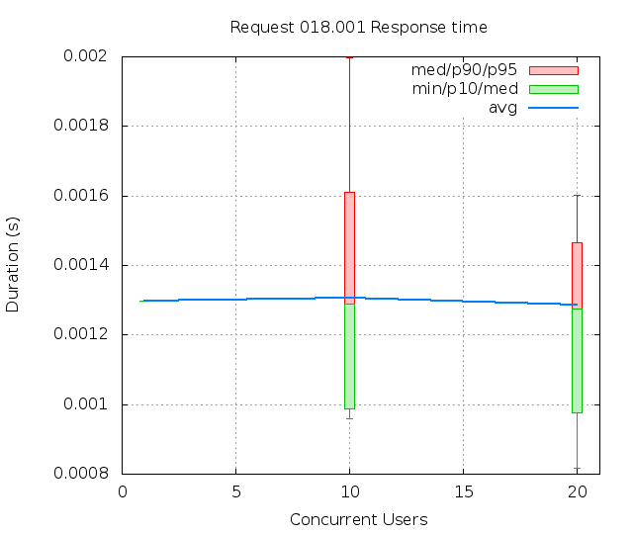

Slide 9
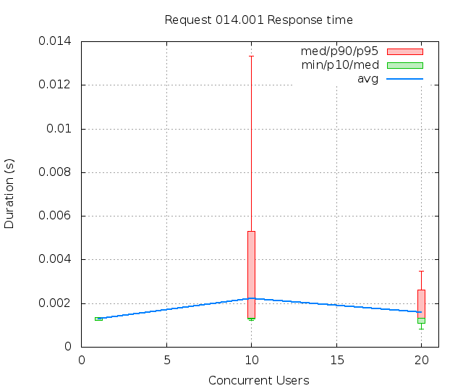
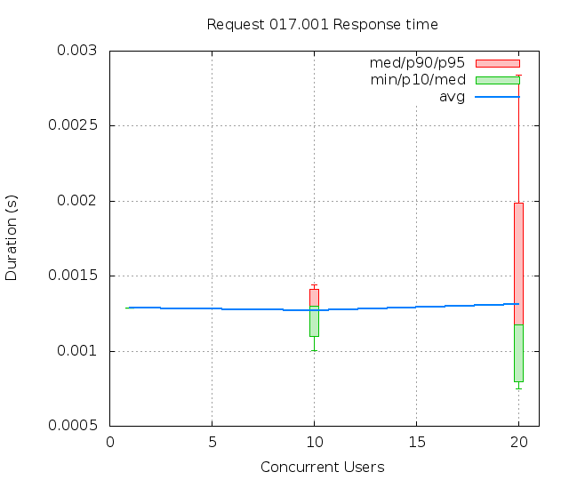
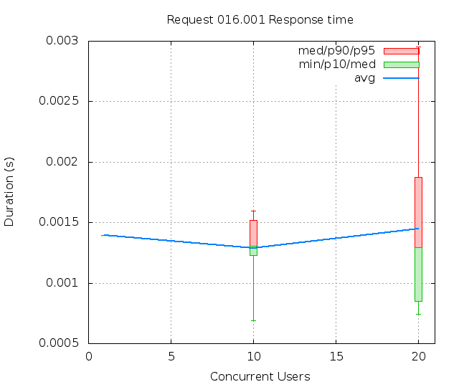
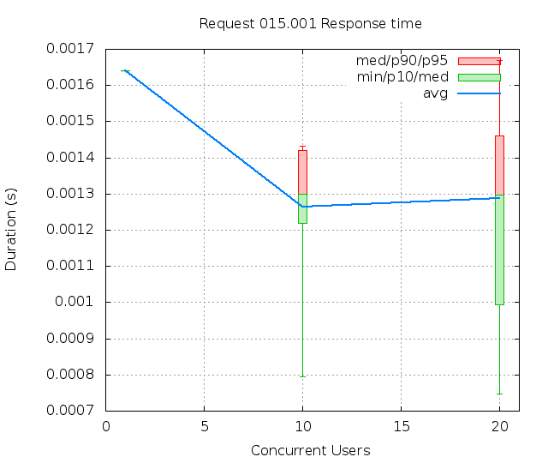
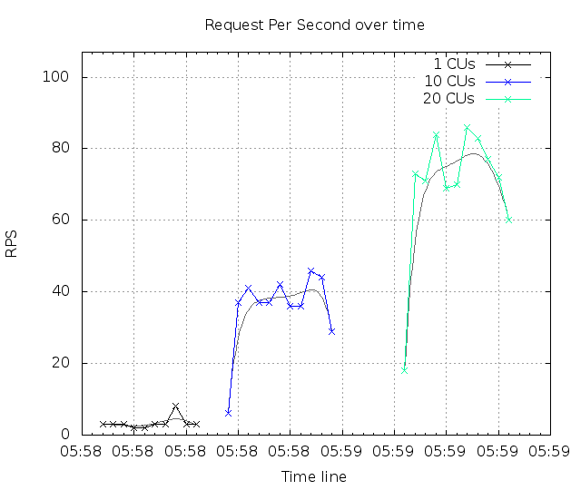
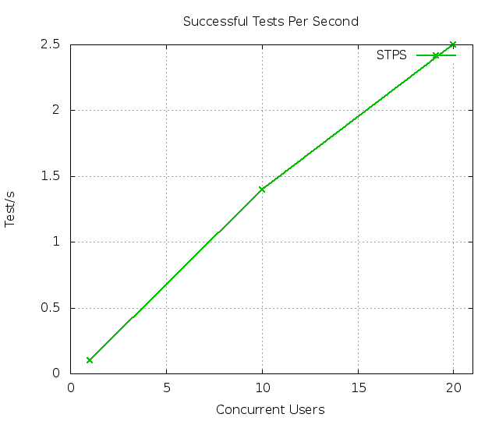
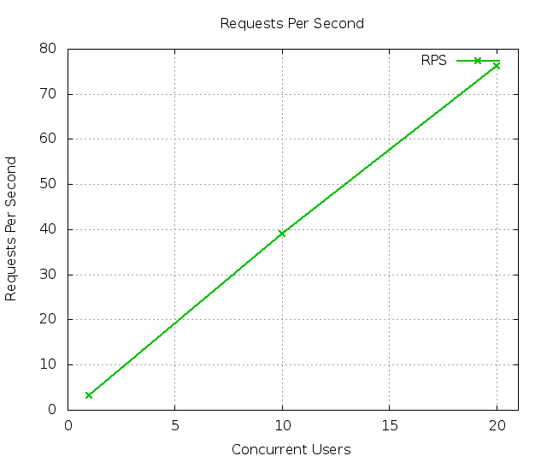
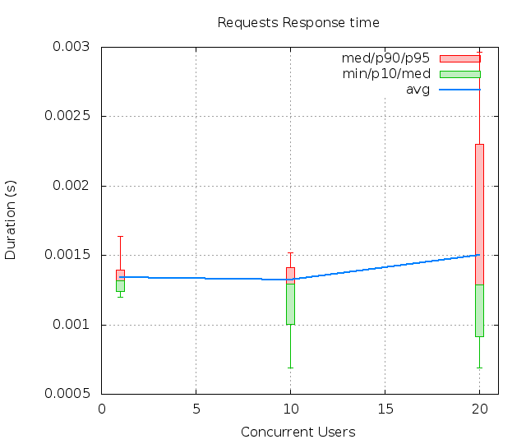

Slide 10

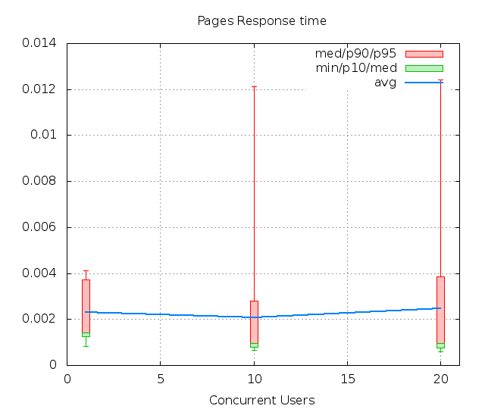
NGINX SERVER TESTING RESULTS

Slide 11
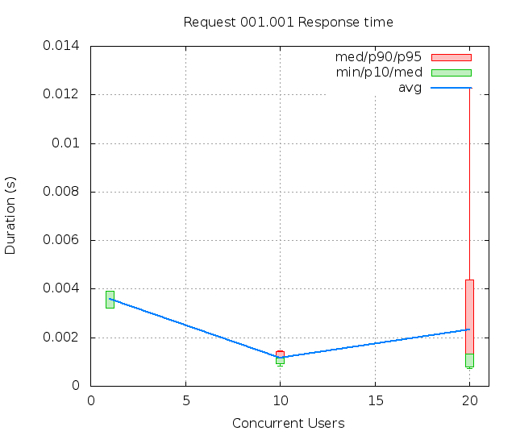
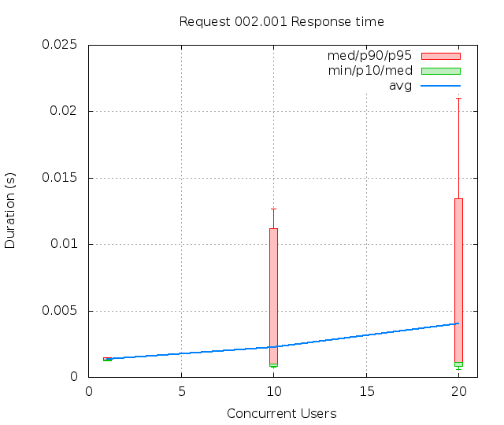
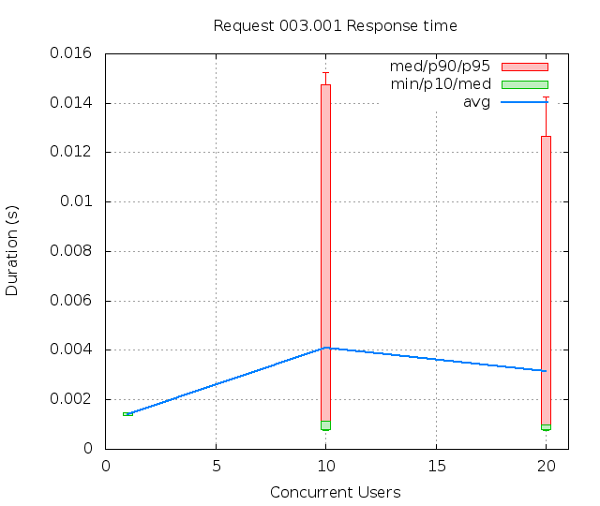
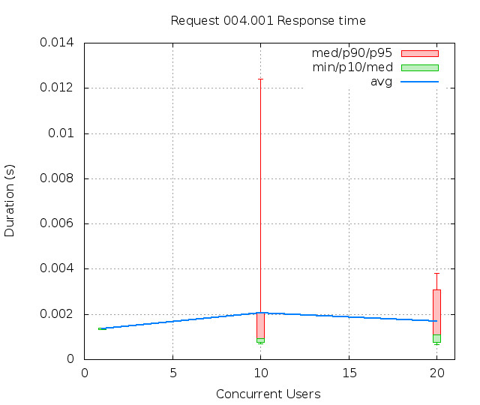
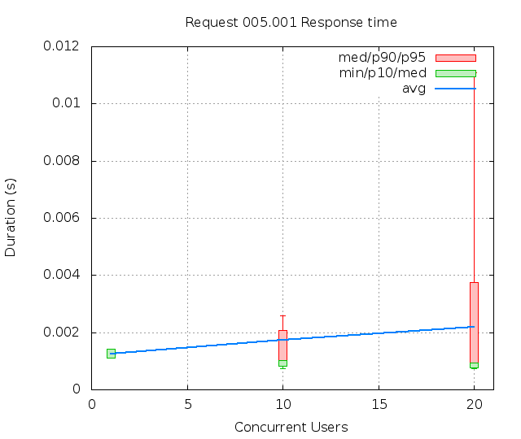
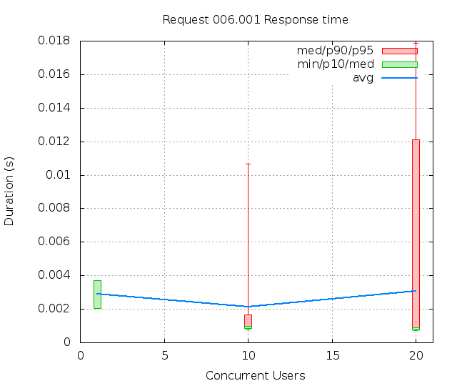
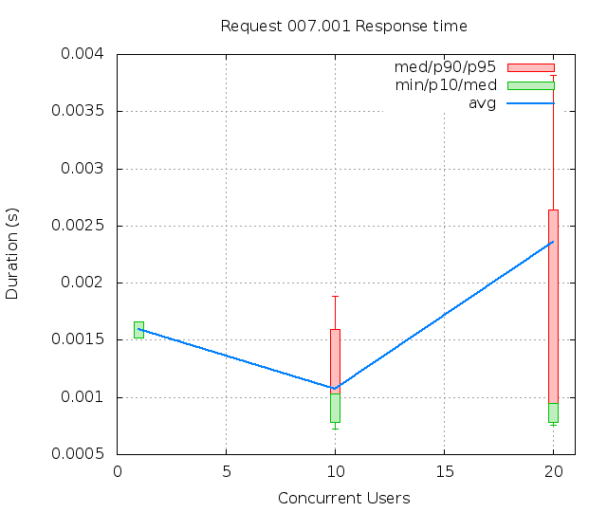
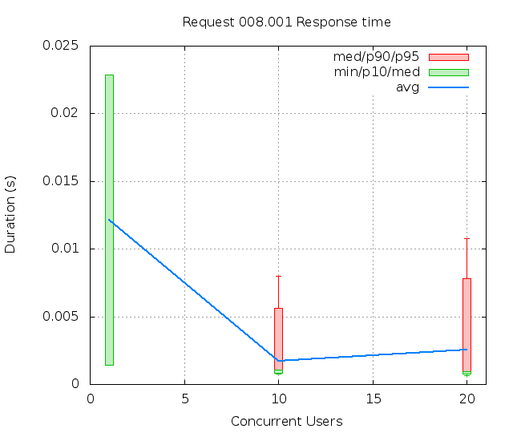

Slide 12
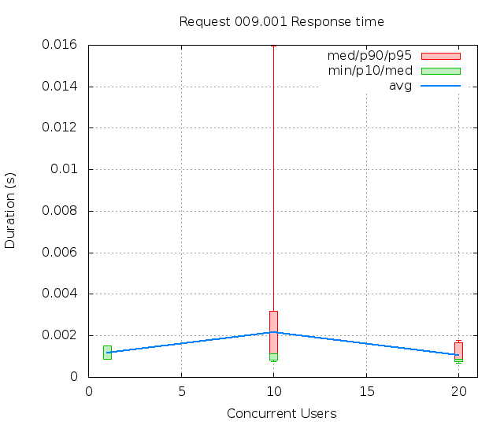
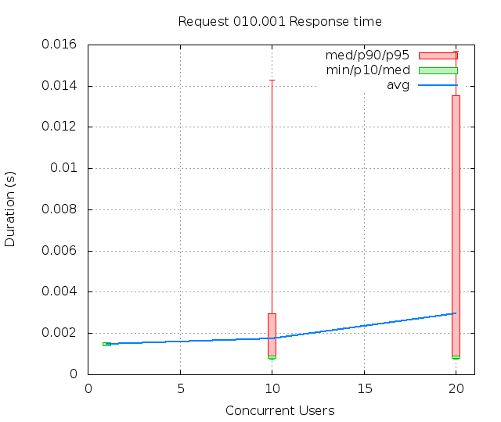
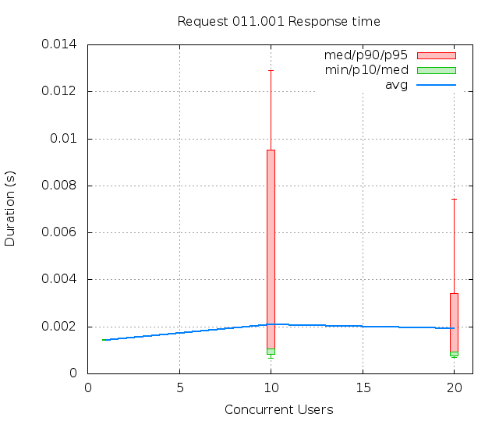
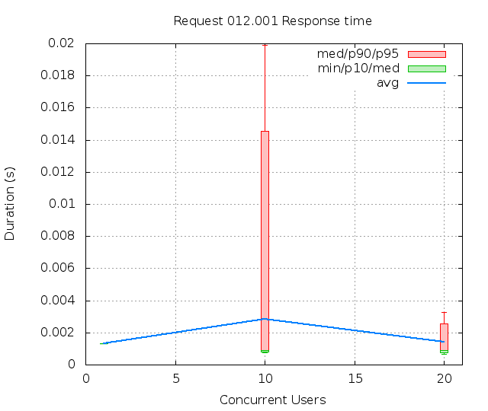
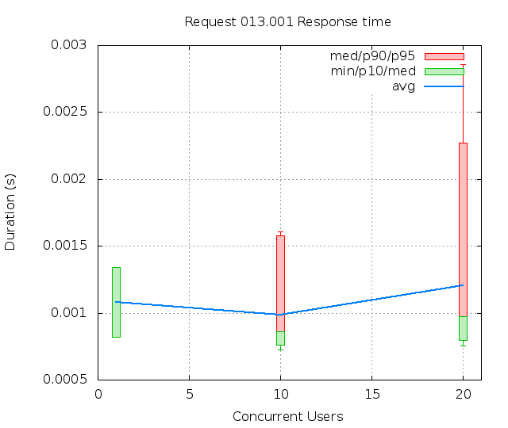
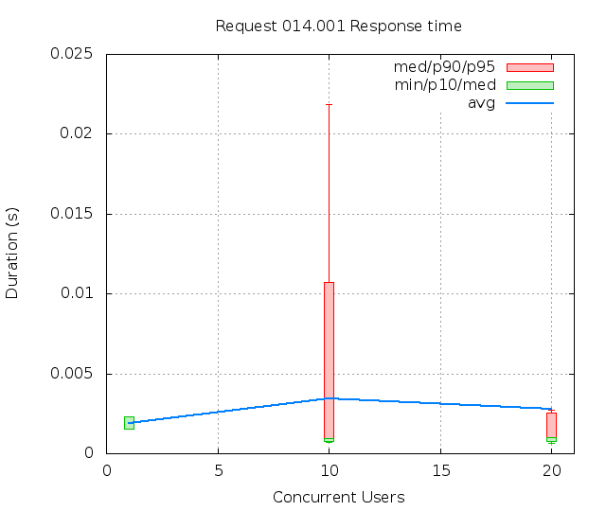
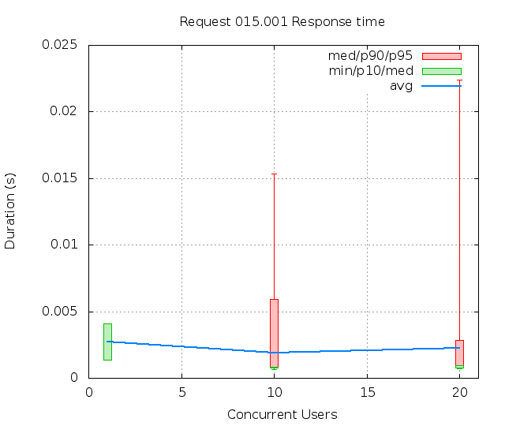
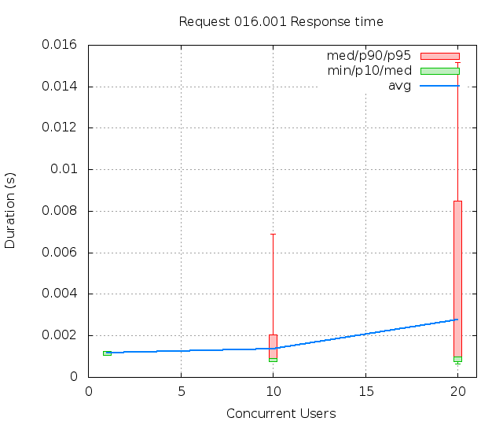

Slide 13
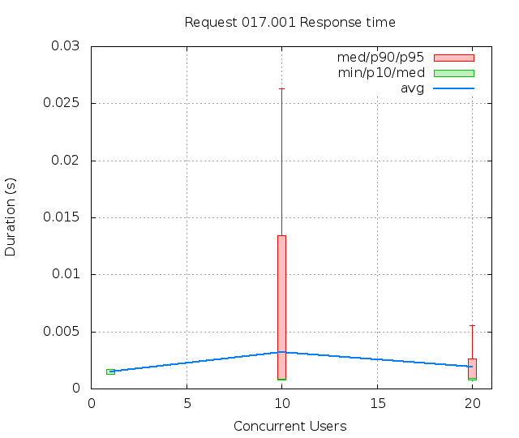
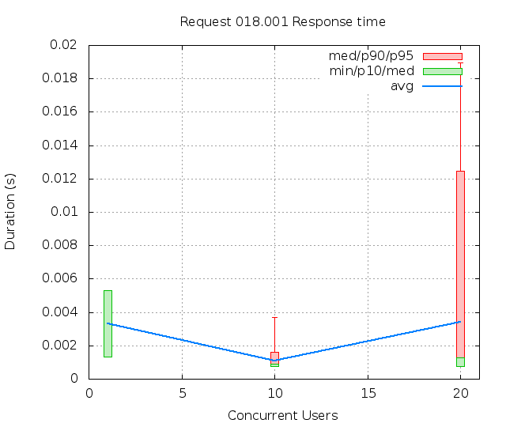
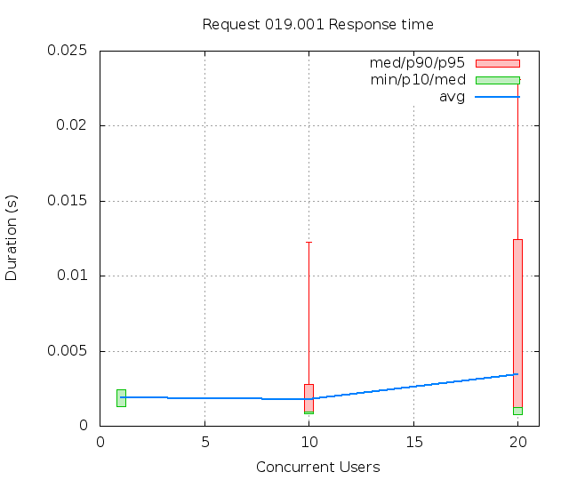
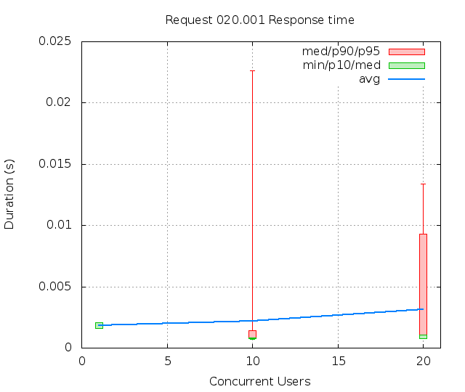
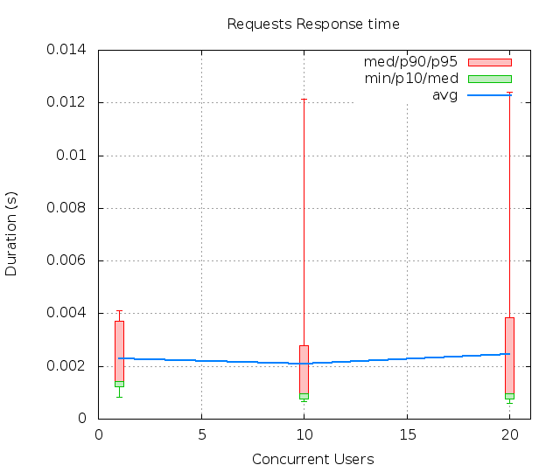




Slide 14
keywords
CUs: Concurrent users or number of concurrent threads executing tests.
Request: a single GET/POST/redirect/XML-RPC request.
Page: a request with redirects and resource links (image, css, js) for an HTML page.
STPS: Successful tests per second.
SPPS: Successful pages per second.
RPS: Requests per second, successful or not.
maxSPPS: Maximum SPPS during the cycle.
maxRPS: Maximum RPS during the cycle.
MIN: Minimum response time for a page or request.
AVG: Average response time for a page or request.
MAX: Maximum response time for a page or request.
P10: 10th percentile, response time where 10 percent of pages or requests are delivered.
MED: Median or 50th percentile, response time where half of pages or requests are delivered.
P90: 90th percentile, response time where 90 percent of pages or requests are delivered.
P95: 95th percentile, response time where 95 percent of pages or requests are delivered.

Slide 15
Mysql Benchmarking
Using Sysbench OLTP

Slide 16
Sysbench
SysBench is a modular, cross-platform and multi-threaded benchmark tool for evaluating OS parameters that are important for a system running a database under intensive load.
The idea of this benchmark suite is to quickly get an impression about system performance without setting up complex database benchmarks or even without installing a database at all.
Current features allow to test the following system parameters:
File I/O performance
Scheduler performance
Memory allocation and transfer speed
POSIX threads implementation performance
Database server performance

Slide 17
Installation
sudo apt-get install sysbench
For complete reference, see man page of sysbench

Slide 18
OLTP Mode
This test mode was written to benchmark a real database performance. At the prepare stage the following table is created in the specified database (sbtest by default):
CREATE TABLE `sbtest` ( `id` int(10) unsigned NOT NULL auto_increment,
`k` int(10) unsigned NOT NULL default '0',
`c` char(120) NOT NULL default '',
`pad` char(60) NOT NULL default '',
PRIMARY KEY (`id`),
KEY `k` (`k`);
Then this table is filled with a specified number of rows.

Slide 19
Execution Modes
Simple
In this mode each thread runs simple queries of the following form:
SELECT c FROM sbtest WHERE id=N ; where N takes a random value in range 1..<table size>
Advanced Transactional
Each thread performs transactions on the test table. If the test table and database support transactions (e.g. InnoDB engine in MySQL), then BEGIN/COMMIT statements will be used to start/stop a transaction. Otherwise, SysBench will use LOCK TABLES/UNLOCK TABLES statements (e.g. for MyISAM engine in MySQL). If some rows are deleted in a transaction, the same rows will be inserted within the same transaction, so this test mode does not destruct any data in the test table and can be run multiple times on the same table.
Non-Transactional
This mode is similar to Simple, but you can also choose the query to run. Note that unlike the Advanced transactional mode, this one does not preserve the test table between requests, so you should recreate it with the appropriate cleanup/prepare commands between consecutive benchmarks.

Slide 20
Prepare Data
Prepare Table and data:
sysbench --test=oltp --oltp-table-size=1000 --mysql-db=dbtest --mysql-user=root --mysql-password=root prepare
Output:
sysbench 0.4.12: multi-threaded system evaluation benchmark
No DB drivers specified, using mysql
Creating table 'sbtest'...
Creating 1000 records in table 'sbtest'...

Slide 21

Test Run
sysbench --test=oltp --oltp-table-size=1000 --oltp-test-mode=complex --num-threads=50 --max-time=60 --mysql-db=dbtest --mysql-user=root --mysql-password=root run
Output:

Slide 22

Kubernetes

Slide 23
What is Kubernetes ?
Kubernetes is a open source orchestration system for managing containerized applications across multiple hosts. Etymologically kubernetes mean “Helmsman of a ship”.
It actively manages the containers to ensure that the state of the cluster continually matches the user's intentions.
As of now, it supports only Docker containers.
Using the concepts of "labels" and "pods", it groups the containers which make up an application into logical units for easy management and discovery.

Slide 24
Why Kubernetes ?
It’s lightweight, simple and accessible.
It’s highly portable into multi-cloud world, public, private or hybrid.
It’s highly modular, designed so that all of its components are easily swappable.
Easy management of Linux containers as a single system to accelerate Dev and simplify Ops.
It provides basic mechanisms for deployment, maintenance, and scaling of applications.

Slide 25
Terminologies
Pods: All containers run inside pods. A pod can host a single container, or multiple cooperating containers. In latter case, the containers in the pod are guaranteed to be co-located on the same machine and can share resources.
Replication Controller: A replication controller ensures that a specified number of pod "replicas" are running at any one time. If there are too many, it will kill some. If there are too few, it will start more. It runs under controller manager service discussed in further slides.
Node: Node is a worker machine in Kubernetes, previously known as Minion.

Slide 26

Architecture !!

Slide 27
On Master..
Docker: It is an open platform for building, shipping and running distributed applications.
Flanneld: It is used as an overlay network which simplifies networking between master and nodes.
Etcd: It is an open-source distributed key value store that provides shared configuration and service discovery. All persistent master state is stored in an instance of etcd. This provides a great way to store configuration data reliably. With watch support, coordinating components can be notified very quickly of changes.
API-Server: The apiserver serves up the Kubernetes API. It mainly processes REST operations, validates them, and updates the corresponding objects in etcd.
Scheduler: The scheduler binds unscheduled pods to nodes.
Controller Manager Server: All other cluster-level functions are currently performed by the Controller Manager. Many controllers come under this category. e.g. Node Controller, Endpoint Controller, Replication Controller, etc.

Slide 28
On Minions
Kubelet: The Kubelet manages pods and their containers, their images, their volumes, etc.
Kube-proxy and Services: Think of Services and kube-proxy as a distributed multi-tenant load-balancer.
Services are defined at the creation time of a pod. Proxy reflects services on each node and can do simple TCP and UDP stream forwarding (round robin) across a set of endpoints.
Minion also needs Docker and Flanneld services to work.

Slide 29
Networking
Flannel is used as an overlay network which simplifies networking between master and nodes. It is backed by etcd server running on master.
Flannel creates an overlay mesh network that provisions a subnet to each node. This gives a unique IP address to each pod from /24 network subnet of host.

Slide 30
References
http://funkload.nuxeo.org/funkload.pdf
http://blog.flux7.com/blogs/benchmarks/using-sysbench-to-benchmark-mysql
https://dev.mysql.com/downloads/benchmarks.html
man of sysbench

Slide 31
Thank you.
Akash Agarwal (201406593) Akhil Singh (201302181)
Soujanya Ponnapalli (201301192) RanVijay Singh (201250899)

